Slide 1

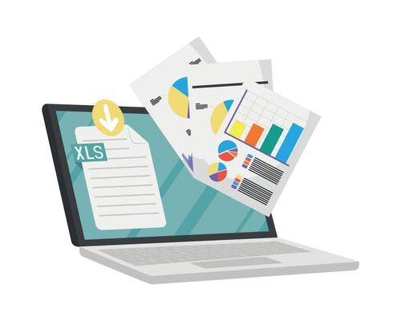

Shop Sales:
A Spreadsheet Analysis
Group 3
M. Inês Barbosa & Paulina Majewska

Slide 2
Project Introduction
What is it about?
A simple business management tool which provides a straightforward finance report regarding the income and expenditure of a business.
Why?
To put into practice the knowledge acquired during the sessions on csv files manipulation.

Slide 3
Project Brief: Spreadsheet Analysis
Required Tasks
To read the data from the spreadsheet;
To collect all of the sales from each month into a single list;
To output the total sales across all months.
Ideas for Extending the Project
To output a summary of the results to a spreadsheet;
To use a data source from a different spreadsheet;
To calculate the following:
○ Monthly changes as a percentage;
○ The average;
○ Months with the highest and lowest sales.

Slide 4
MoSCoW Method
Must
The users should be able to see list of sales and expenditures from every month;
The users should be able to see total sum of sales and expenditures across all months;
The users should be able to see sales and expenditure monthly changes.
Should
The monthly changes should be graphically presented;
The average sales and expenditures should be outputted;
The month with highest and lowest sales should be outputted.
Could
The sales from every month could be graphically presented;
A similar analysis could be done for each product;
A new csv file could be created with some of the obtained data.
Won’t
The user won’t be able to access all the information analysed in the new file;
The information won’t be organized by product, just for month.

Slide 5


Project Showcase
2 Approaches

Slide 6
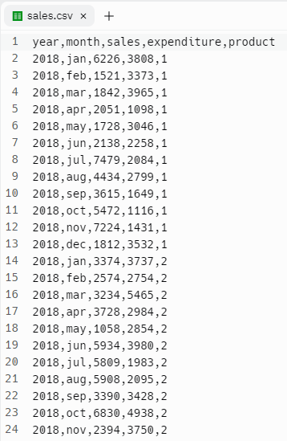
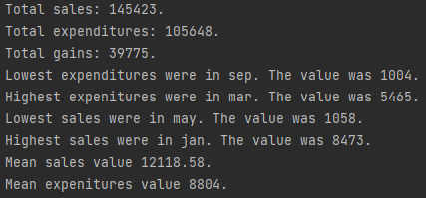
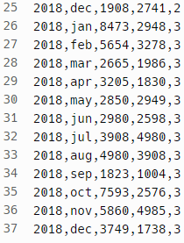
csv File – First Approach
https://replit.com/@InesBarbosa2/Project-Group-3#main.py

Slide 7
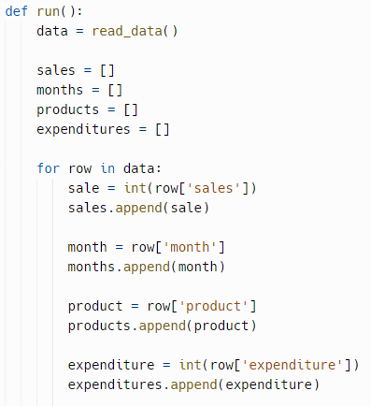
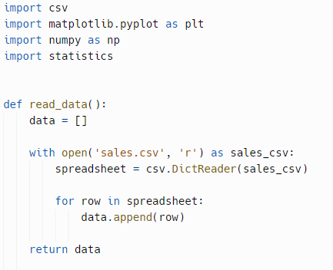
Code – First Approach
Reads the data from the spreadsheet “sales.csv” and takes information from it

Slide 8
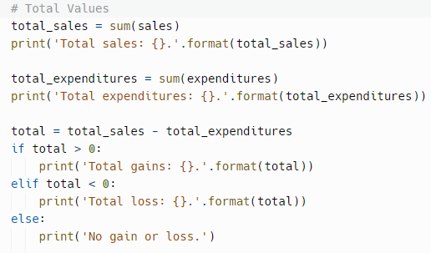
Code – First Approach
Calculates the total sales and expenditures and verifies if the business gets gain or losses, printing the correspondent value

Slide 9
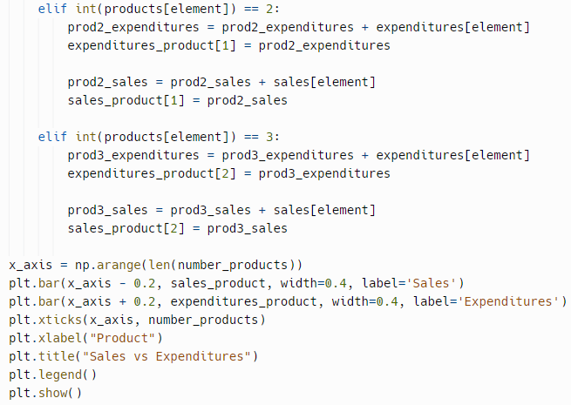
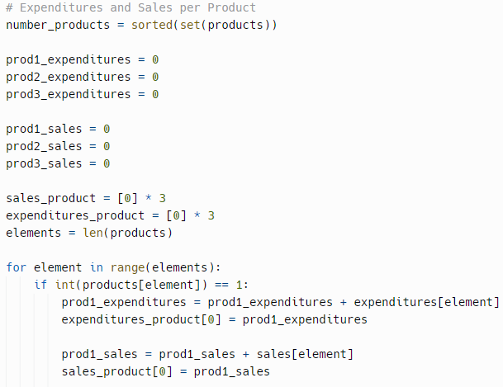
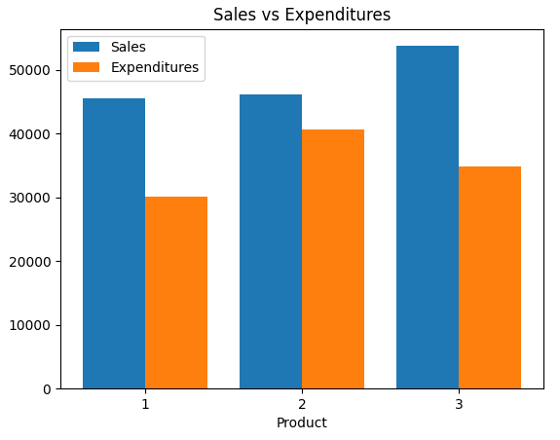
Code – First Approach
Calculates the total sales and expenditures of each product and plot the results in a bar graph

Slide 10
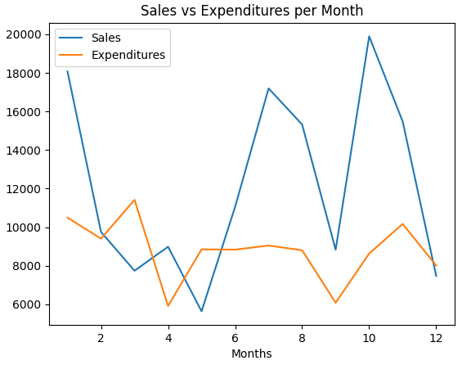
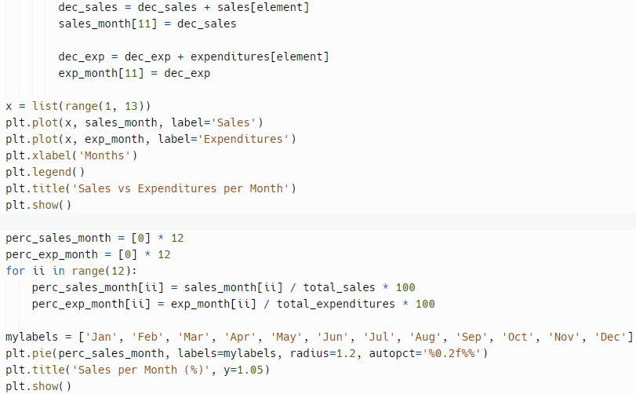
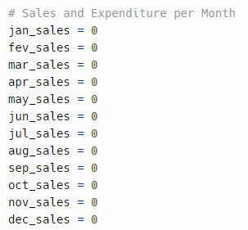
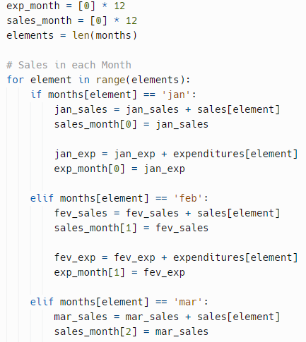
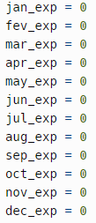
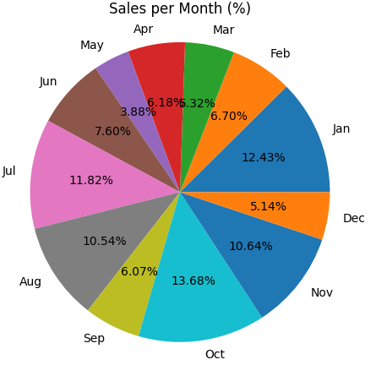
Code – First Approach
Calculates the total sales and expenditures of each month and plot the results in a linear graph and the sales per month in a pie graph
…

Slide 11
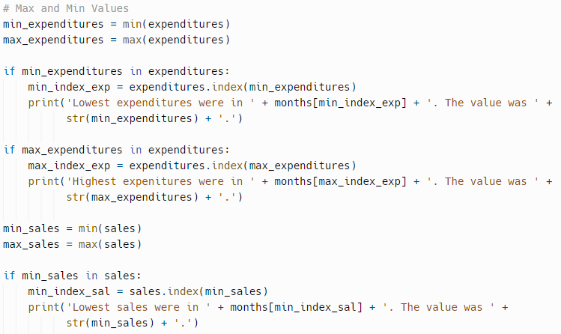
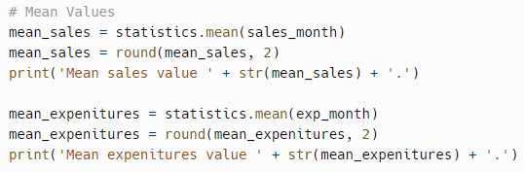

Code – First Approach
Calculates the sales and expenditures mean values and finds the maximum and the minimum values of sales and expenditures and prints the correspondent value and month

Slide 12
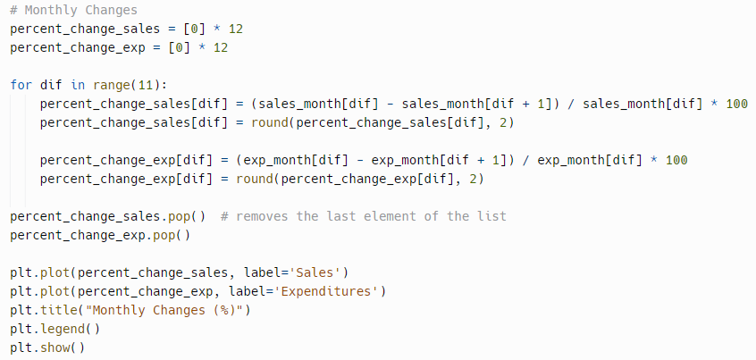
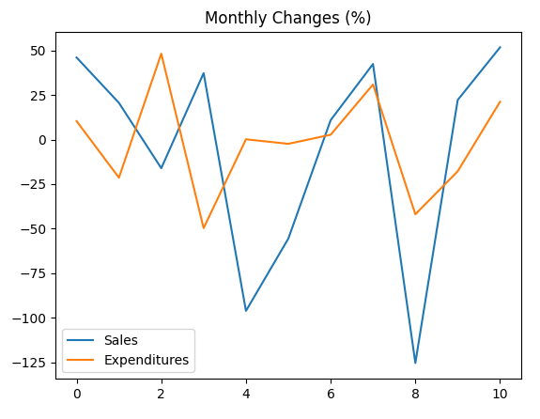
Code – First Approach
Calculates the monthly changes of sales and expenditures and plots these variations

Slide 13
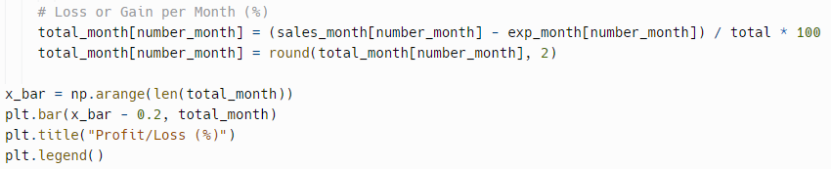
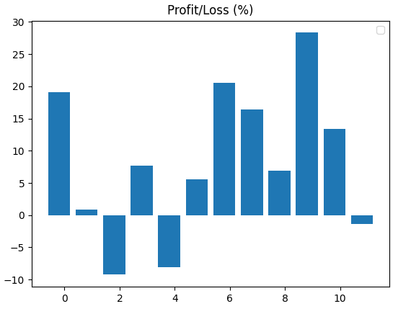
Code – First Approach
Calculates the percentage (%) of gain or loss in each month and plots the results in the bar graph

Slide 14
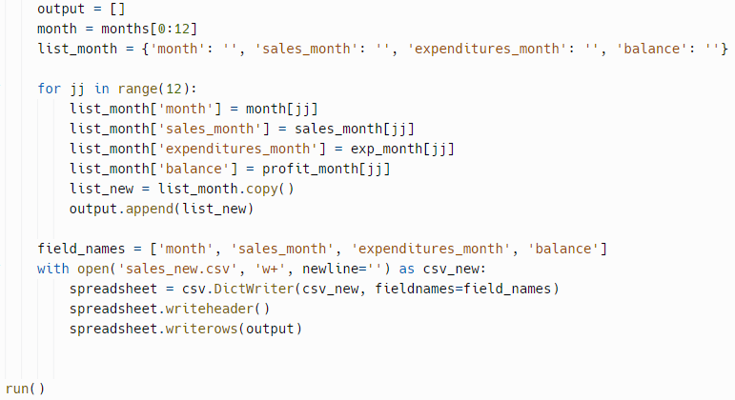
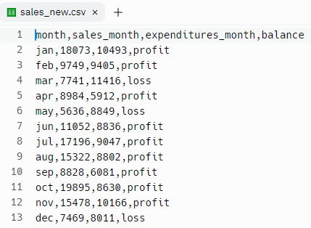
Code – First Approach
Creates a new file “sales_new.csv” and outputs some of the obtained results in it

Slide 15
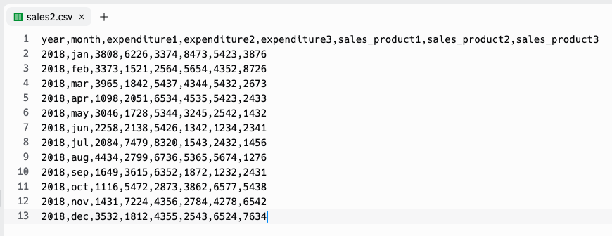
csv file – Second Approach
https://replit.com/@pmajewska/New-test-1#main.py

Slide 16
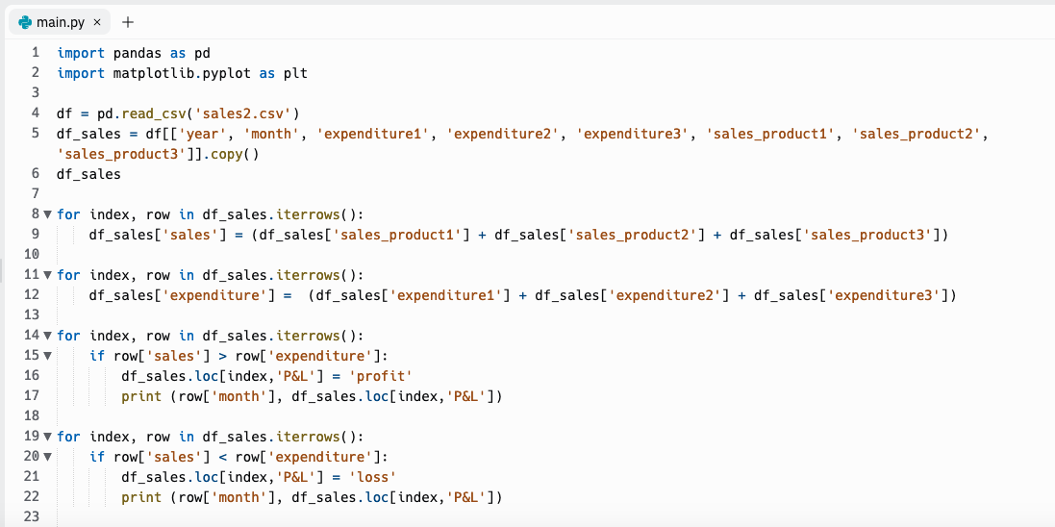
Code – Second Approach

Slide 17
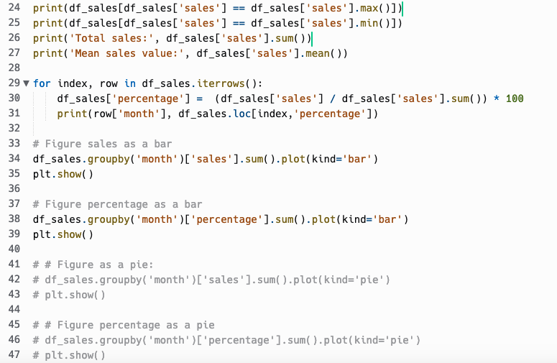
Code – Second Approach

Slide 18

Code – Second Approach
DataFrame in Pandas
A Pandas DataFrame is a 2 dimensional data structure, like a 2 dimensional array or a table with rows and columns.
Import pandas and matplotlib
Matplotlib is a comprehensive library for creating static, animated and interactive visualizations in Python

Slide 19
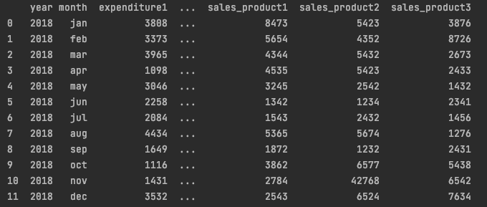
Code – Second Approach
Opens the csv file, reads all columns and creates virtual copy
and prints a table like this:

Slide 20
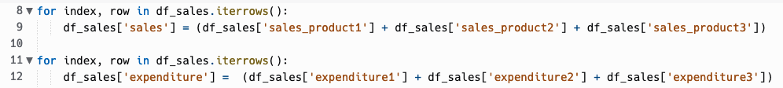
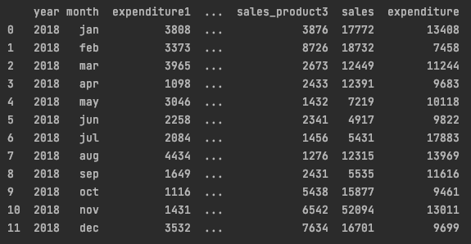
Code – Second Approach
Obtains the total sales and expenditures of each product in each month
Sum of all sales in month
Sum of all expenditures in month
And adds this new information to the table:

Slide 21
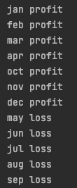
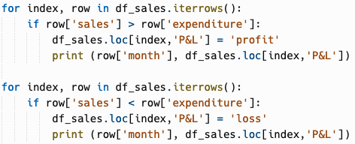
Code – Second Approach
Creates a new virtual column with the profit or loss of each month and prints the obtained results
Profit
Loss

Slide 22

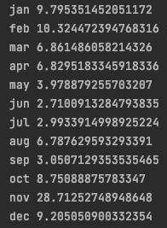
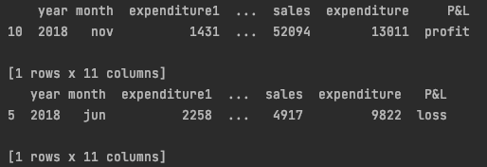
Code – Second Approach
Calculates and prints the:
○ Total sales and sales average
○ Monthly changes (%)
○ Months with the highest and lowest sales

Slide 23
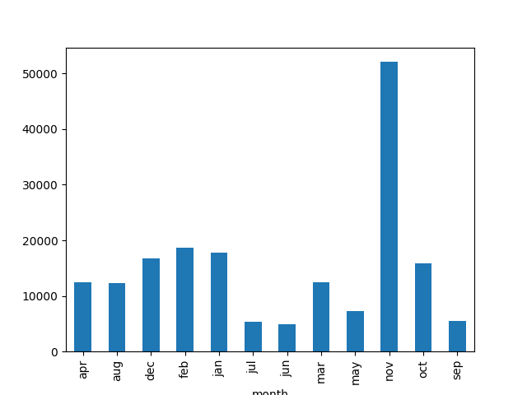
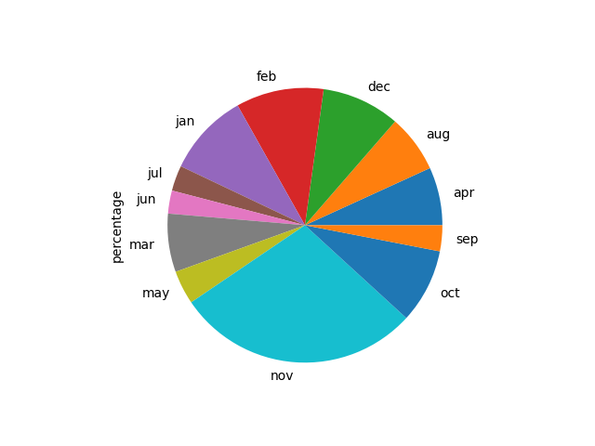
Code – Second Approach
Plots the sales in each month in a graph bar and and the correspondent percentages (%) in a “pie” graph

Slide 24
Reflections
What Was Learned
How to do different graphs;
To work with a csv file;
To apply new libraries.
If We Had More Time
To analyse more complex csv files;
To explore new libraries and functions;
To improve the code.
Difficulties & Challenges
To work with new libraries;
Output data for a new csv file.

Slide 25

Thank You!

